Slide 1
Lesson 05 – Kubernetes Deploynment

Slide 2
Lesson Objectives
Module Overview
Creating a Deployment YAML
Deploying a Deployment
Kubernetes Deployment Theory
Self-healing and Scaling
Rolling Updates and Rollbacks
Notes:
Add instructor notes here.

Slide 3
Kubernetes Deployment – Module Overview
Deployment can manage multiple replicas of same pods.
It is a full fledge object in kubernetes which is defined in manifest and posted to API Server
Deployment leverage another object Replica Set
Deployment use Replica set to provide self healing and scaling.
Notes:
A Deployment provides declarative updates for Pods and ReplicaSets.
You describe a desired state in a Deployment, and the Deployment Controller changes the actual state to the desired state at a controlled rate.
You can define Deployments to create new ReplicaSets, or to remove existing Deployments and adopt all their resources with new Deployments.
Kubernetes deployment is an abstraction layer for the pods.
The main purpose of the deployment object is to maintain the resources declared in the deployment configuration in its desired state.
A deployment configuration can be of YAML or JSON format.

Slide 4
Kubernetes Deployment – Key Things to understand About Deployments
A Deployment can schedule multiple pods. A pod as a unit cannot scale by itself.
A Deployment represents a single purpose with a group of PODs.
A single POD can have multiple containers and these containers inside a single POD shares the same IP and can talk to each other using localhost address.
Notes:
A Deployment is responsible for creating and updating instances of your application

Slide 5
Kubernetes Deployment – Key Things to understand About Deployments
To access a Deployment with one or many PODs, you need a Kubernetes Service endpoint mapped to the deployment using labels and selectors.
A deployment should have only stateless services. Any application that requires state management should be deployed as a Kubernetes StatefulSet.

Slide 6
Kubernetes Deployment – Deployment YAML:
To access a Deployment with one or many PODs, you need a Kubernetes Service endpoint mapped to the deployment using labels and selectors.
A deployment should have only stateless services. Any application that requires state management should be deployed as a Kubernetes StatefulSet.

Slide 7
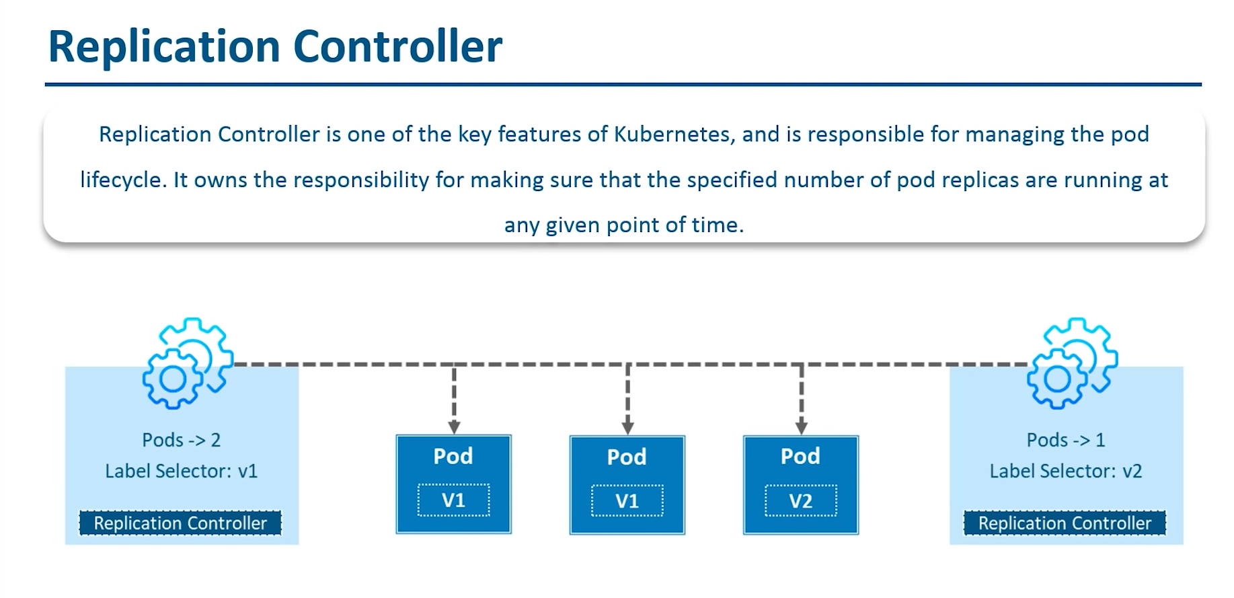
Kubernetes Deployment – Module Overview-Replication Controller
Notes:
Replication Controller is one of the key features of Kubernetes, which is responsible for managing the pod lifecycle.
It is responsible for making sure that the specified number of pod replicas are running at any point of time.
It is used in time when one wants to make sure that the specified number of pod or at least one pod is running.
It has the capability to bring up or down the specified no of pod.

Slide 8
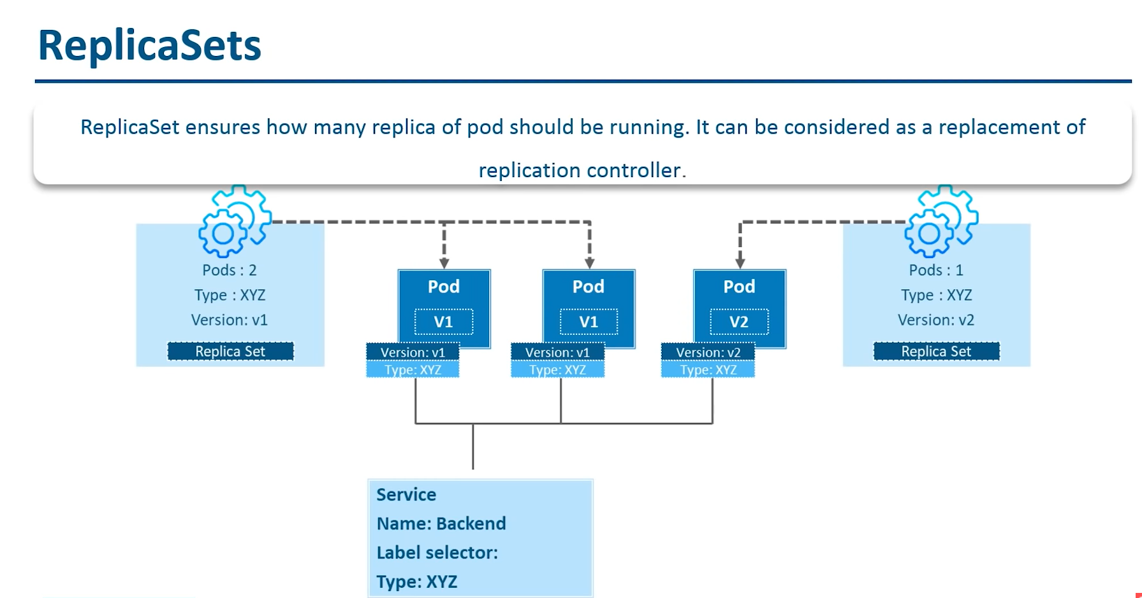
Kubernetes Deployment – Replica Sets
Notes:
ReplicaSet
-A ReplicaSet's purpose is to maintain a stable set of replica Pods running at any given time.
-As such, it is often used to guarantee the availability of a specified number of identical Pods
-Replica Set ensures how many replica of pod should be running.
- It can be considered as a replacement of replication controller.
-The key difference between the replica set and the replication controller is,
the replication controller only supports equality-based selector [it match exact label phrase
whereas the replica set supports set-based selector.[set base selector allows filtering keys according to a set of values.
So, in other words, the selector based selector will look for pods whose label has been mentioned in the set. Say your label key says app in (nginx, NPS, Apache). Then, with this selector, if your app is equal to any of nginx, NPS, or Apache,
then the selector will take it as a true result.]

Slide 9
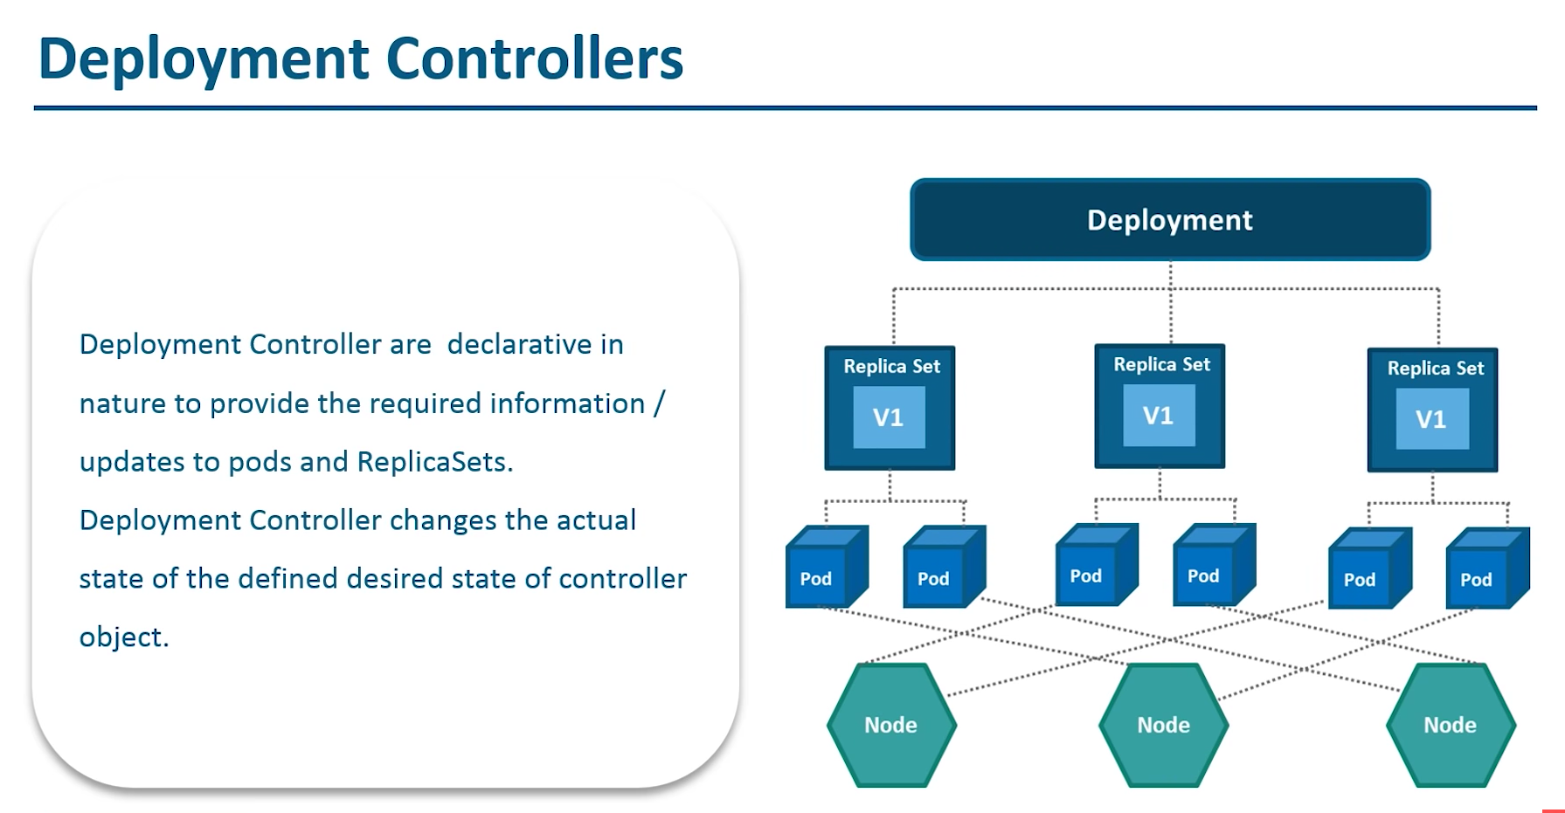
Kubernetes Deployment – Module Overview

Slide 10
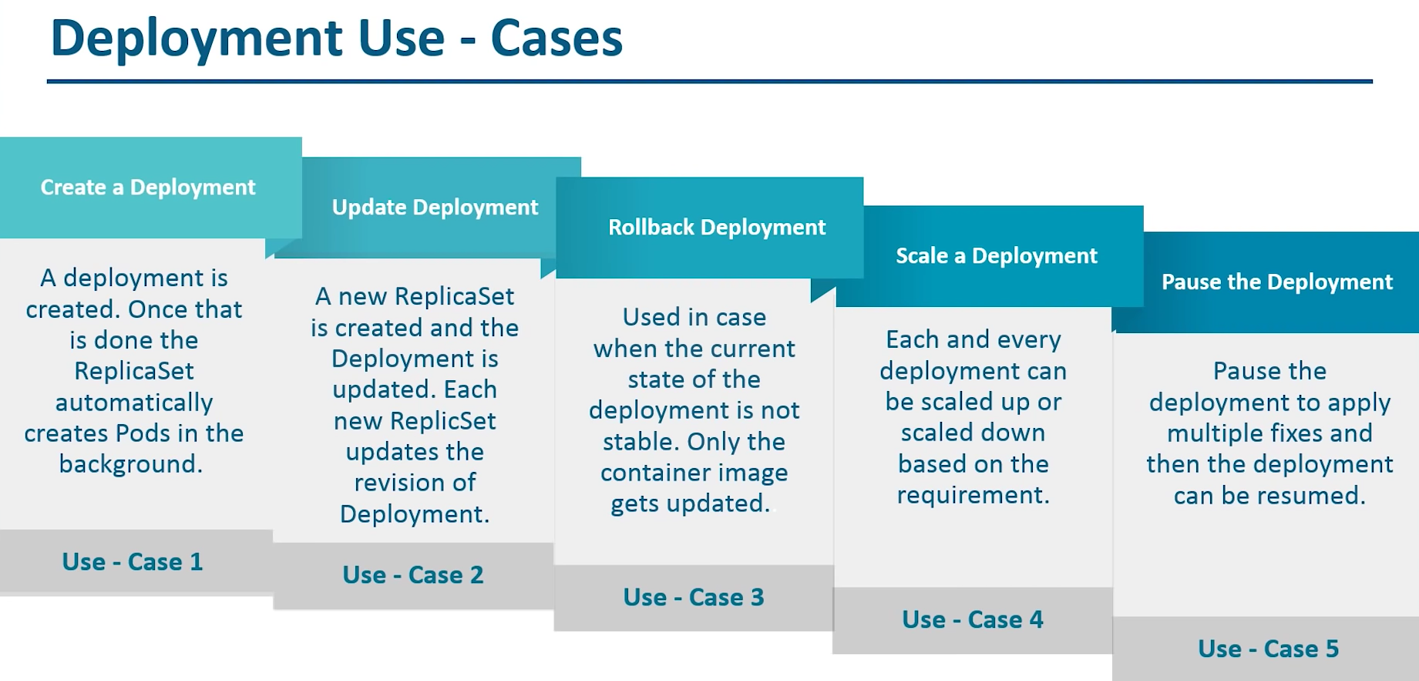
Kubernetes Deployment – Module Overview

Slide 11
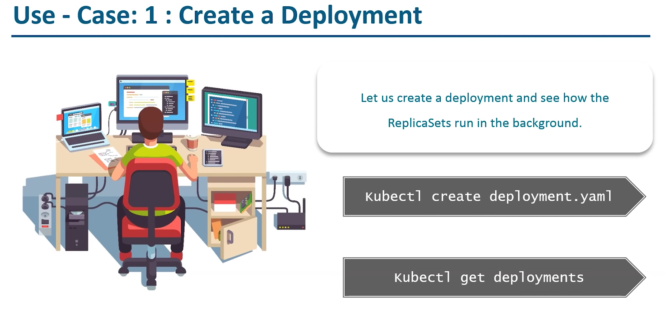
Kubernetes Deployment – Create Deploynement

Slide 12
Kubernetes Deployment – Deployment YAML Demo
002-MySQLDep-Without-PV-Headless-W

